Slide 1


Walchand College Of Engineering, Sangli
(An Government Aided Institute)
Department Of Information Technology
(Academic year 2022-23)
Project Presentation
on
To design and study cheetah optimizer algorithm

Slide 2
Walchand College Of Engineering, Sangli
(An Government Aided Institute)
Department Of Information Technology
Institute Name : Walchand College Of Engineering, Sangli
Institute code : 6007
Class : Final Year
Course: Information Technology
Project Instructor: Prof. Mr. A.J. Umbarkar Sir
Prepared by :-
Name | PRN No
Sakshi Kamble | 2020BTEIT00205
Pranjali Nanaware | 2019BTEIT00067
Arundhati Wandhekar | 2019BTEIT00013
Pratik Pawar | 2019BTEIT00006
Rahul Kumar | 2019BTEIT00002
Prathmesh Patil | 2019BTEIT00009

Slide 3
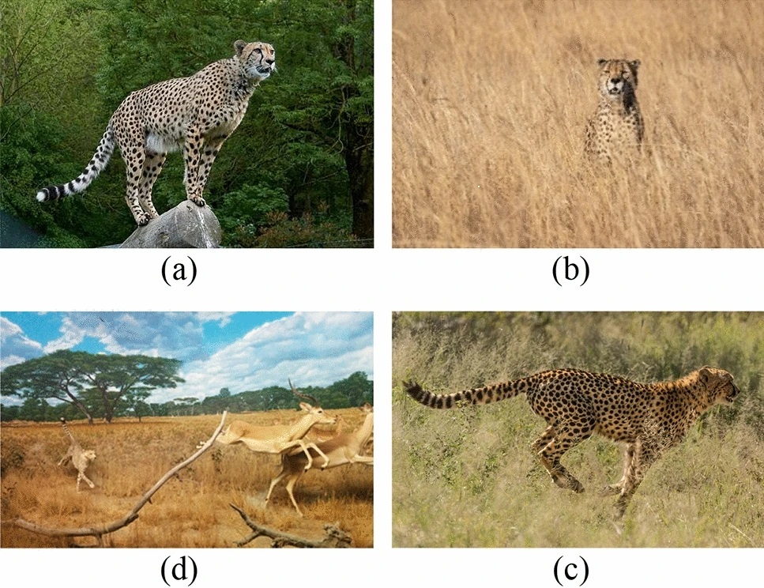
Problem Statement :
Walchand College Of Engineering, Sangli
(An Government Aided Institute)
Department Of Information Technology
To Design and study Cheetah optimizer algorithm/
To study cheetah optimizer and solve real world problem.

Slide 4
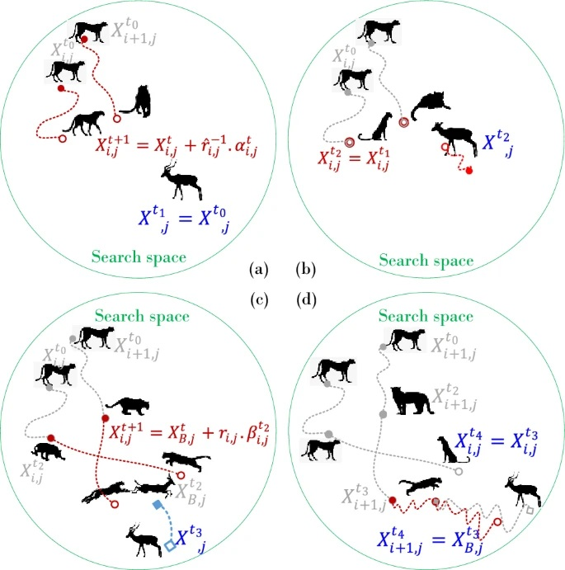
Objectives :
Walchand College Of Engineering, Sangli
(An Government Aided Institute)
Department Of Information Technology
To understand Cheetah Optimizer.
To implement Cheetah Optimizer algo for optimization.
To analyze the result and compare it with other algorithm
To solve real life problem on cheeah optimizer algorithm

Slide 5
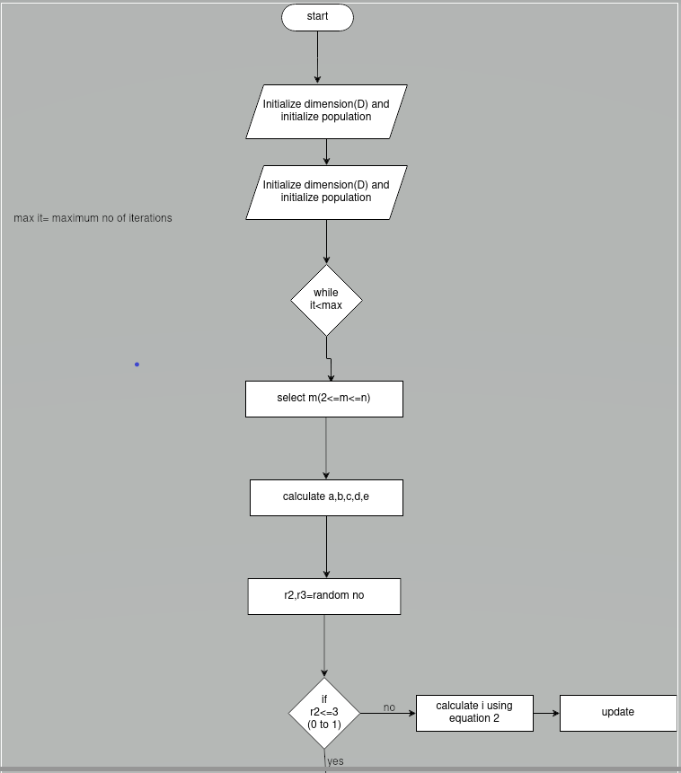
Flow Of System :
Walchand College Of Engineering, Sangli
(An Government Aided Institute)
Department Of Information Technology

Slide 6
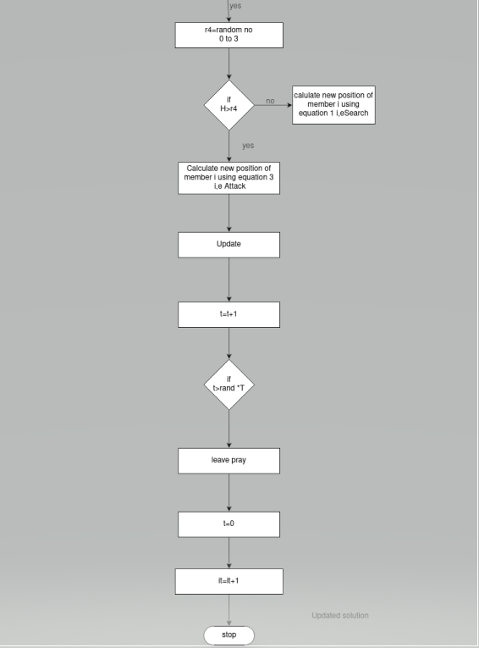
Flow Of System :
Walchand College Of Engineering, Sangli
(An Government Aided Institute)
Department Of Information Technology

Slide 7

Walchand College Of Engineering,Sangli
(An Government Aided Institute)
Department Of Information Technology
Methodology
Start
Prepare for new hunt.
Initialize the population size and dimentions.
Generate the initial population of cheetahs and fitness of cheetahs.
Start searching and move to next and update the solutions of members and leader.

Slide 8



Walchand College Of Engineering,Sangli
(An Government Aided Institute)
Department Of Information Technology
Methodology
Search strategy equation :
Sit-and-wait strategy equation :
3. Attack equation :

Slide 9
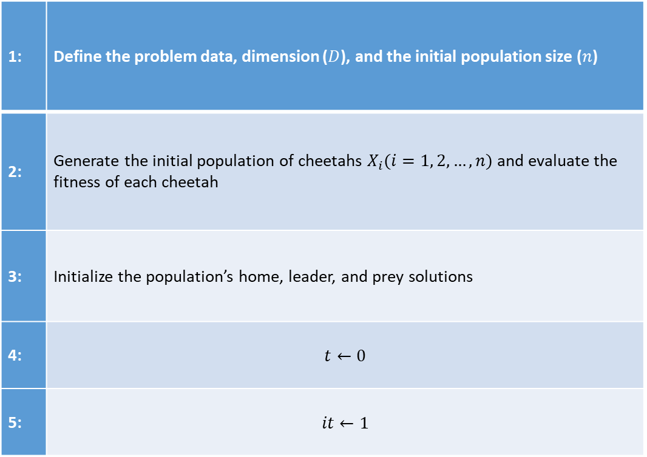
Walchand College Of Engineering,Sangli
(An Government Aided Institute)
Department Of Information Technology
Algorithm
1: | Define the problem data, dimension ($D$), and the initial population size ($n$)
2: | Generate the initial population of cheetahs $X_{i}(i=1, 2,…,n)$ and evaluate the fitness of each cheetah
3: | Initialize the population’s home, leader, and prey solutions
4: | $$t←0$$
5: | $$it←1$$

Slide 10
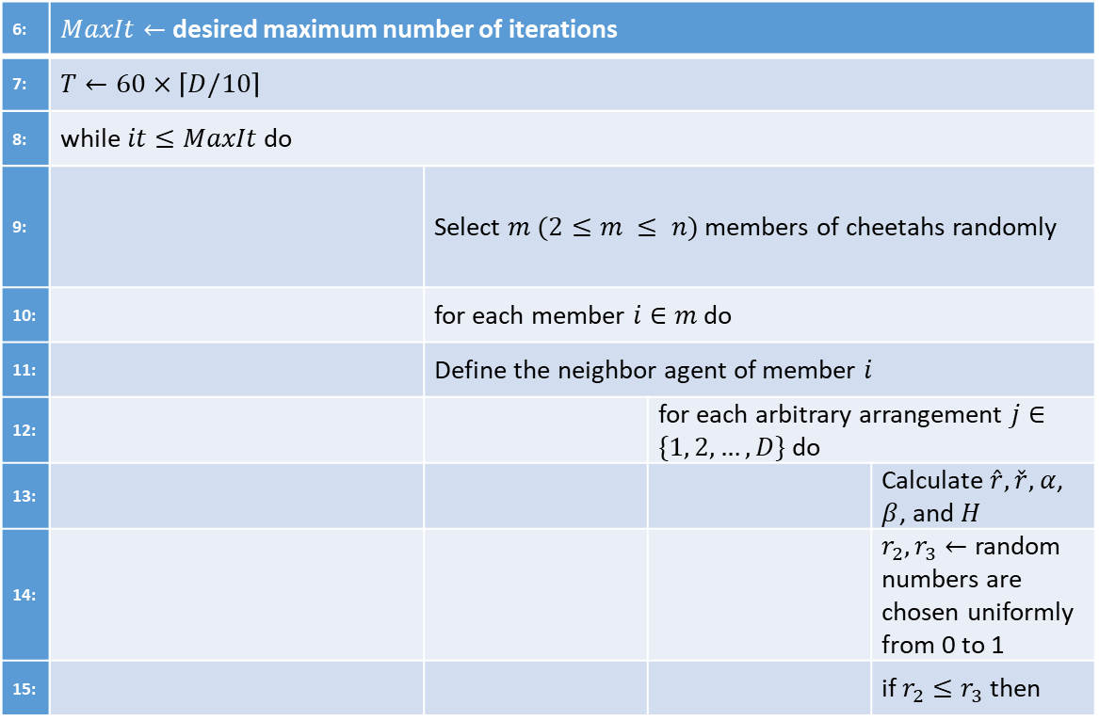
Walchand College Of Engineering,Sangli
(An Government Aided Institute)
Department Of Information Technology
Algorithm
6: | $MaxIt←$ desired maximum number of iterations
7: | $T←60×\left\lceil D/10\right\rceil$
8: | while $it≤MaxIt$ do
9: |  | Select $m (2≤m ≤ n)$ members of cheetahs randomly
10: |  | for each member $i∈m$ do
11: |  | Define the neighbor agent of member $i$
12: |  |  | for each arbitrary arrangement $j∈\{1, 2,…,D\}$ do
13: |  |  |  | Calculate $\hat{r}, \check{r},$ $α$, $β$, and $H$
14: |  |  |  | $r_{2},r_{3}←$ random numbers are chosen uniformly from 0 to 1
15: |  |  |  | if $r_{2}≤r_{3}$ then

Slide 11
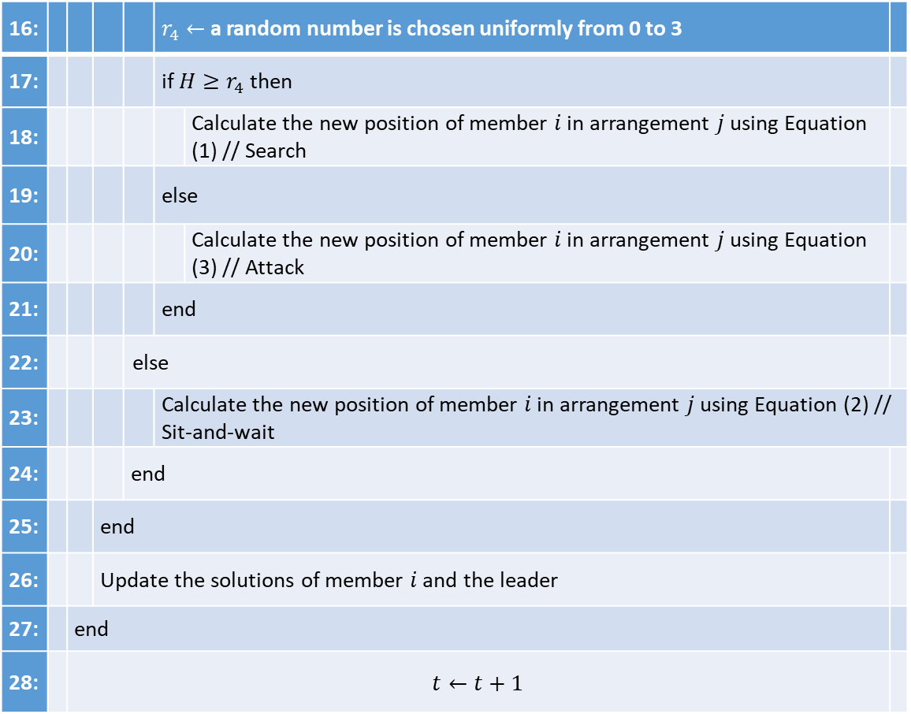
Walchand College Of Engineering,Sangli
(An Government Aided Institute)
Department Of Information Technology
16: |  |  |  |  | $r_{4}←$ a random number is chosen uniformly from 0 to 3
17: |  |  |  |  | if $H≥r_{4}$ then
18: |  |  |  |  |  | Calculate the new position of member $i$ in arrangement $j$ using Equation (1) // Search
19: |  |  |  |  | else
20: |  |  |  |  |  | Calculate the new position of member $i$ in arrangement $j$ using Equation (3) // Attack
21: |  |  |  |  | end
22: |  |  |  | else
23: |  |  |  |  | Calculate the new position of member $i$ in arrangement $j$ using Equation (2) // Sit-and-wait
24: |  |  |  | end
25: |  |  | end
26: |  |  | Update the solutions of member $i$ and the leader
27: |  | end
28: |  | $$t←t+1$$
Algorithm

Slide 12
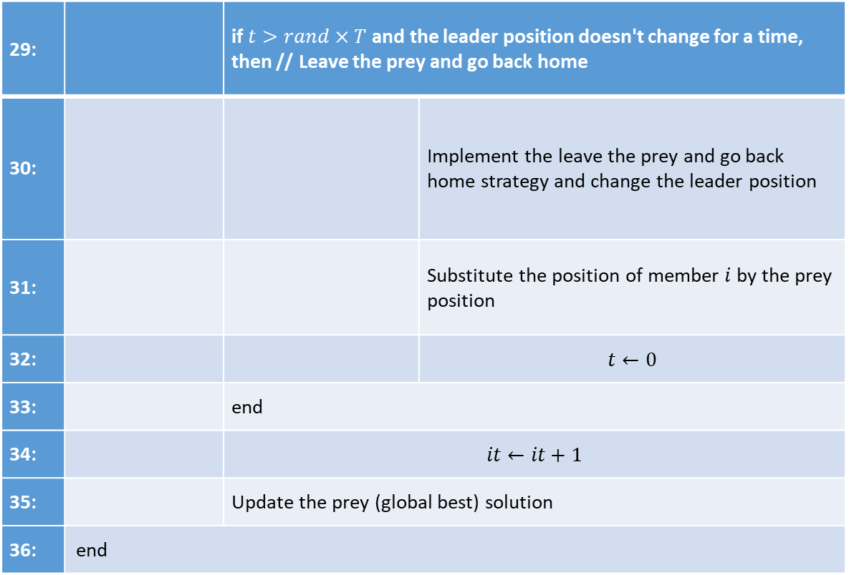
Walchand College Of Engineering,Sangli
(An Government Aided Institute)
Department Of Information Technology
Algorithm
29: |  | if $t>rand×T$ and the leader position doesn't change for a time, then // Leave the prey and go back home
30: |  |  | Implement the leave the prey and go back home strategy and change the leader position
31: |  |  | Substitute the position of member $i$ by the prey position
32: |  |  | $$t←0$$
33: |  | end
34: |  | $$it←it+1$$
35: |  | Update the prey (global best) solution
36: | end

Slide 13
Technology :
Walchand College Of Engineering, Sangli
(An Government Aided Institute)
Department Of Information Technology
Python

Slide 14

Walchand College Of Engineering,Sangli
(An Government Aided Institute)
Department Of Information Technology
References
https://www.nature.com/articles/s41598-022-14338-z
https://www.researchgate.net/publication/361610357_The_cheetah_optimizer_a_nature-inspired_metaheuristic_algorithm_for_large-scale_optimization_problems

Slide 15


